Slide 1
DBDA INNOVATIVE ASSIGNMENT
Submitted By:-
Aftab Engaria(12bce003).
Kunal Chhabaria(12bce016).
Sanket Jain(12bce081).
Guided By:- Prof. Anitha Modi

Slide 2

Company Visited: Prompt Softech
Company Profile
Embedded Computing Systems
Soft-tech for Dairy & Other Co-operatives.
Web and Mobile Based Apps
Best Software Product Company- Gujarat 2013- GESIA
Best Electronic Product Company-Gujarat 2014-GESIA
Best Product Company-Gujarat 2015- PENGUIN

Slide 3
Basic Q&As
Database Used: SQL Server 2008 R2
No. of DBA’s : 2
No. of Servers:
2 Onsite Servers( With Virtualization)
2 Servers at NEESA Technologies, Grand Cambay.
Back Up of Updated Data: Every 30 minutes
Thus, in a worst case scenario data lost is only of 30 minutes.

Slide 4
Continued…
Whole Database Back-up: Everyday 1Am to 4Am.
Scheduler is set.
E-mail alert when back-up starts and concludes.
E-mail alert also in case of any discrepancy.
Database Designing responsibility is assigned mainly to the application designers & developers as they would be better suited to perform the same.

Slide 5
Continued…
Access Rights to Employees: Limited
For example, the Embedded Systems department is given access rights only of the tables and data corresponding to the Embedded Systems.
Full access rights: DBA and Owner(So basically, only the DBA! )
Reason for choosing SQL Server 2008 R2 over other database: GUI, Cost-effective(Compared to Oracle) and easy to train the staff.

Slide 6
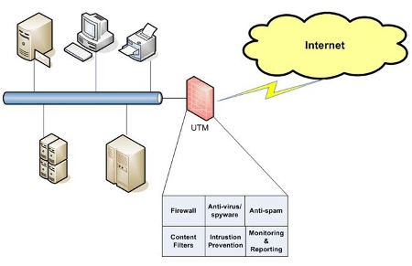
Advanced Q & A’s
Safety from Security and Intrusion:
Uniform Threat Management(UTM) .

Slide 7
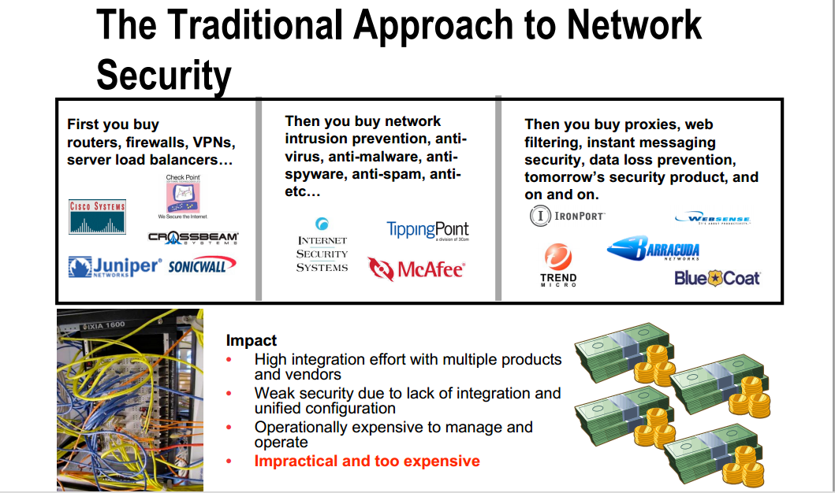
Traditional Approach vs UTM

Slide 8
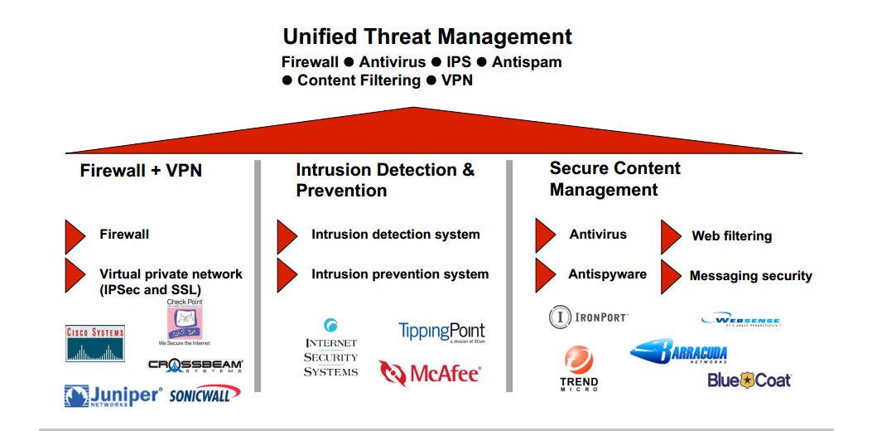
Continued…

Slide 9
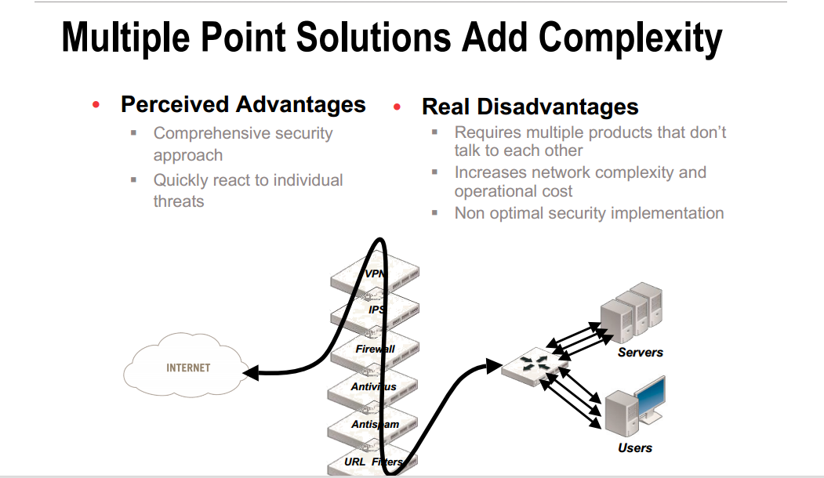
Continued…

Slide 10
Advanced Q&As
Data and Tables:
Tables and data arranged Clientwise.
Some tables even contain crores of entries.
Employee data table contain queries that increase their salary based on the number of days they have worked in the company.
Web Access to Employees: Limited.
Dell SecureWorks is used for the same.
Just sites categorized under ‘Education’ &’Learning’ are allowed access through Firewall of Dell SecureWorks for Prompt Softech.
Firewall is just one of the many features available under Dell SecureWorks.

Slide 11
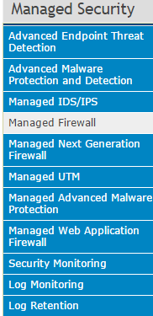
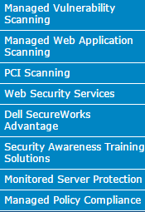
Features of Dell SecureWorks

Slide 12
Software Application Usage
A venue is fixed where farmers, various co-op.
gather to get their milk weighed and various components of their milk measured.
The milk is to be sent to various dairies such as Amul, Mother Dairy, Dudhsagar, Dairy India etc. and the software applications developed by Prompt Softech act as a bridging technological medium between them.
The data implying the quantity of milk, the fat content in the milk, water content etc. are sent through a registered IP and secure username and password to the servers at Prompt Softech.
And, then the information is transferred to various dairies.

Slide 13
Continued..
The firewall detects that the information is coming through an unregistered IP, it instantaneously blocks all the data coming through it.
For a new user to be registered, Prompt Softech provides them with a valid username and password and consequently registers their IP onto their servers.
The precision of the application goes to the point that it even contains the exact departure time at which the milk is dispatched, the vehicle number and vehicle type containing the product as well as the expected time to reach its destination.
The necessary updates in the database are made almost immedaitely.

Slide 14
Dairy Cloud: Future Prospect
The vision of Prompt Softech is to integrate Cloud Services with its current software applications.
The desired information required at different dairy centers are processed and directly sent to the locations using Cloud Services.
The data gets stored on the Cloud Platform, get processed and the relevant information is sent across to various dairies connected.

Slide 15
** Expecting 30/30 ☺
THANK YOU

